Slide 1

CS345/SOFTENG350 Tutorial Week 9 Morae
DO NOT OPEN MORAE UNTIL YOU ARE IN A GROUP
ONLY OPEN ONE COPY PER GROUP
Get into groups of 3+
Work through the tutorial PDF
https://www.cs.auckland.ac.nz/courses/compsci345s1c/tutorials/
Sam Kavanagh

Slide 2
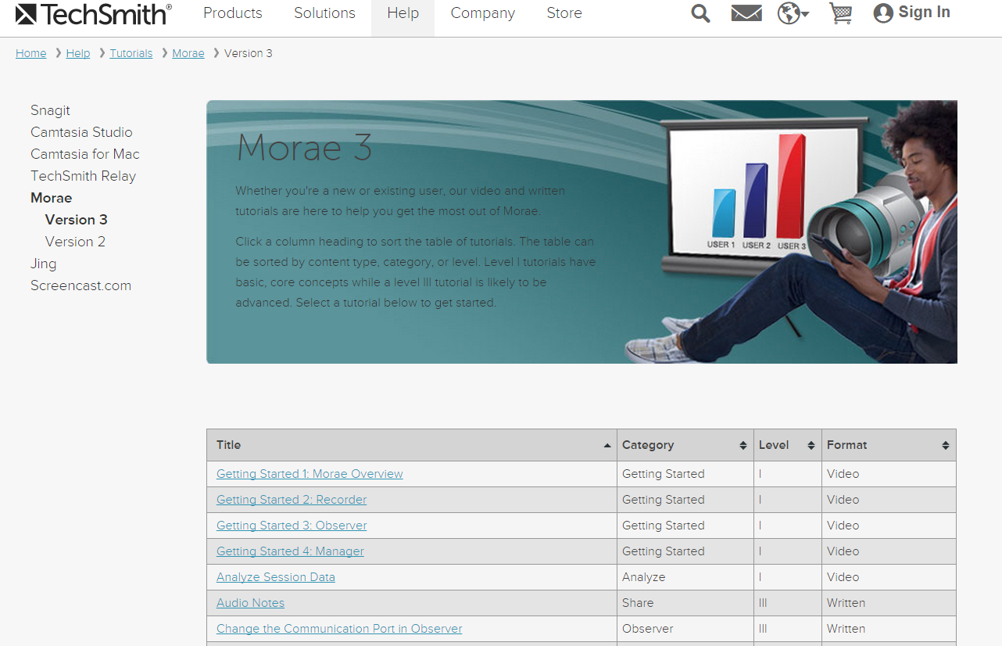
Task 1
Task 3
Task 2

Slide 3
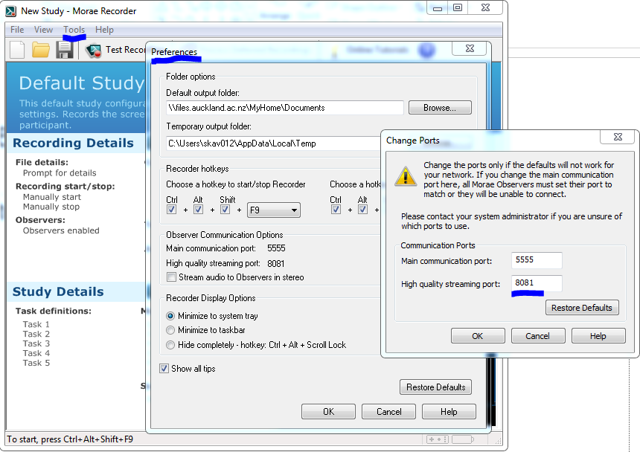
Port Issue

Slide 4
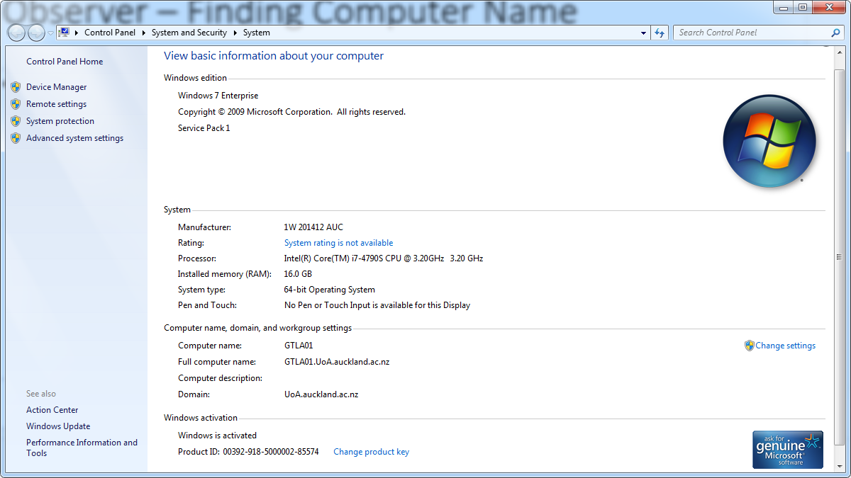
Observer – Finding Computer Name

